Slide 1
Short-Term Load Forecasting of Australian National Electricity Market by Hierarchical Extreme Learning Machine
Park Jee Hyun
07 JUL 2017
-
SungKyunGwan University – undergraduate student
Nanyang Technological University – exchange student

Slide 2
Contents
Introduction
Hierarchical extreme learning machine (H-ELM)
Implemented structure
Test results
Conclusion
References

Slide 3
1. Introduction
Predicting future demand load for electricity is considered an essential process in power system operation.
Good quality Short-Term Load Forecasting (STLF) is very important for economical aspect and contributes to reliability of power system [5], [6].
There have been continuous efforts to achieve high load forecasting accuracy.
Improvement of the performance of the learning algorithm model
How well the input data features are extracted through the pre-processing process

Slide 4
2. Hierarchical Extreme Learning Machine
Extreme Learning Machine theory
H-ELM framework

Slide 5
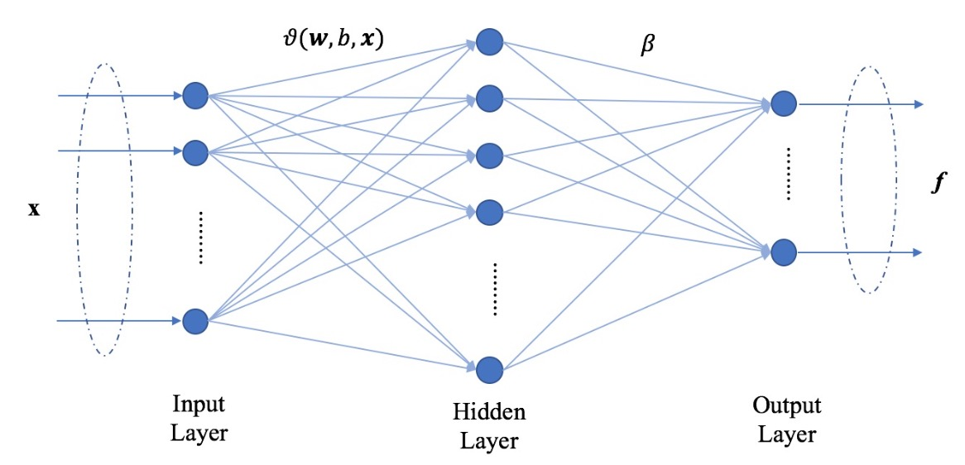
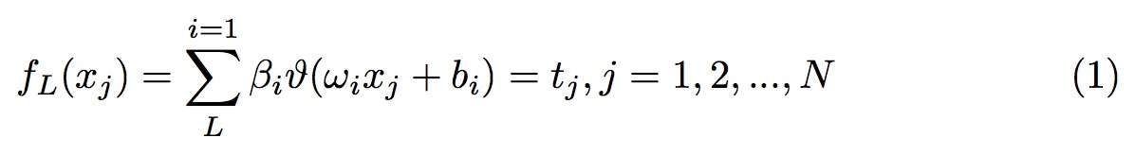
2.a. Extreme Learning Machine theory
Notes:
Given a training data set with N samples, the output function of the SLFN with L hidden nodes and activation function θ.
The activation function is expressed as (1).

Slide 6
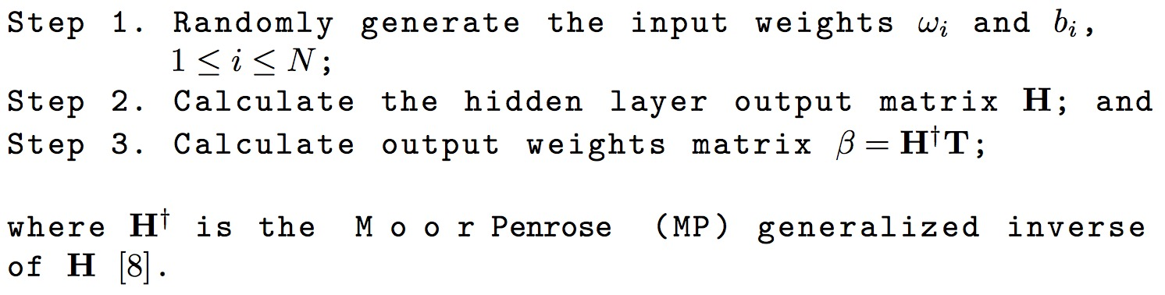
2.a. Extreme Learning Machine theory
ELM learning can be summarized as the following major three steps:
Notes:
ELM is completely different from traditional iterative learning algorithms
as it randomly selects the input weights and biases for hidden nodes,
ω and b and analytically calculates the output weights, β, by finding least-square solution [8].
once ELM parameters of hidden layers of the ELM are generated randomly, it does not need to be tuned. Therefore, its training speed can be thousands of times faster [3].

Slide 7
2.a. Extreme Learning Machine theory
Pros:
Due to the characteristics of the ELM based SLFN, we can obtain very short training time, excellent efficiency and good generalize performance [3].
Cons:
It randomly selects the input weights and biases for hidden nodes, and cause a crux in the stability of its outputs [4].
Notes:
Due to the characteristics of the ELM based SLFN, we can obtain very short training time, excellent efficiency and good generalize performance [3]. However, it randomly selects the input weights and biases for hidden nodes, and cause a crux in the stability of its outputs [4].

Slide 8
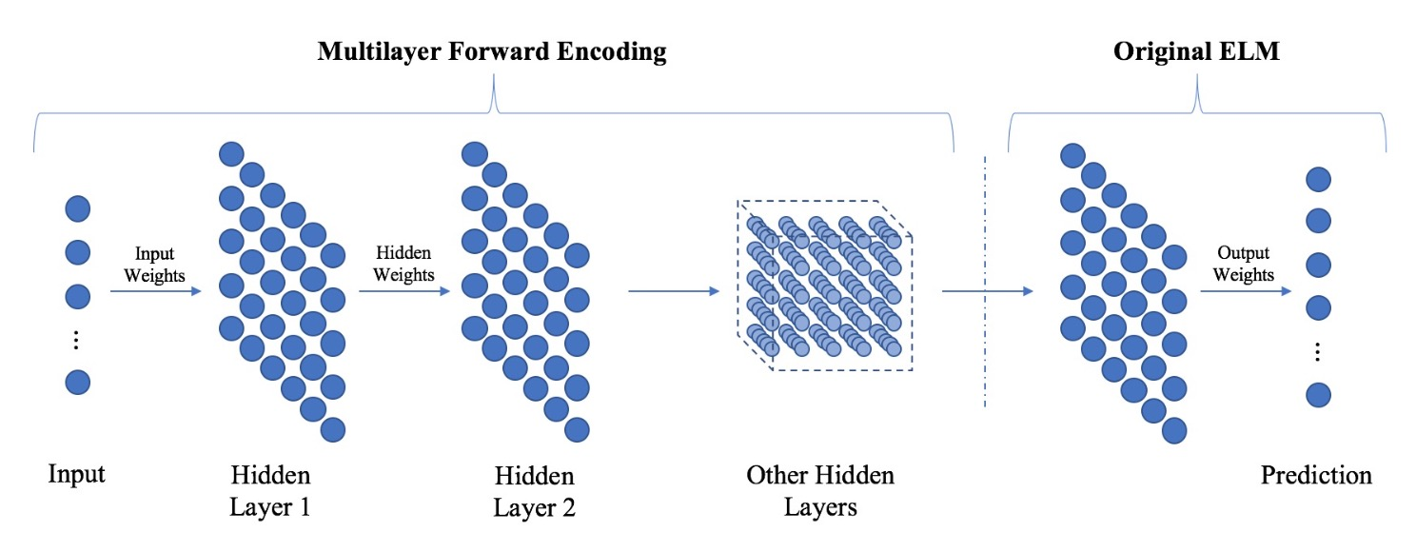
2.b. H-ELM framework
HELM consists of two parts
Unsupervised hierarchical feature representation
Supervised feature classification

Slide 9
2.b. H-ELM framework
Unsupervised hierarchical feature representation
It receives raw input data and projects it to the ELM random feature space, which plays an important role in extracting hidden feature information of input training data.
High-level sparse features can be obtained as output values through N-layer unsupervised learning, which is then passed to the input data of the second stage.
Supervised feature classification
The final decision is made through regression, which is the same process as the existing ELM.
Notes:
Since H-ELM receives input of high-level sparse features obtained from unsupervised feature learning, instead of raw input data,
it is able to obtain more accurate and stable performance.
The experiments designed in the back will confirm that H-ELM shows better performance than ELM.

Slide 10
3. Implementation Structure
Data used in experiments
Data pre-processing strategies
Correlation study
STLF architecture
Input & Output

Slide 11
3.a. Data used in experiments
Australian National Electricity Market (NEM)
Contents :
Load profile of New South Wales (NSW) region from 1 January 2006 to 31 December 2015
k-th date of the data :
Australian Bureau of Meteorology (BOM)
Contents :
ㅍof NSW region from 1 January 2006 to 31 December 2015
the k-th date of the data :
Notes:
Normally in STLF, load data is used as input label data and weather data is used as input feature data.

Slide 12
3.b. Data pre-processing strategies
The feature of the weather data is too poor to be used as the input feature data of the STLF.
BOM data show only one record per day for maximum temperature, minimum temperature, rainfall, and solar exposure.
Using these data directly as input feature dataset can not provide sufficient features to train the STLF model
To overcome this problem, we suggest following data pre-processing strategy
To enrich the features of input data, include the historical load data from the NEM in the input dataset consisting of the weather data of the BOM.
Notes:
Which historical load data to be included in the feature input dataset will be described in the following correlation study.

Slide 13
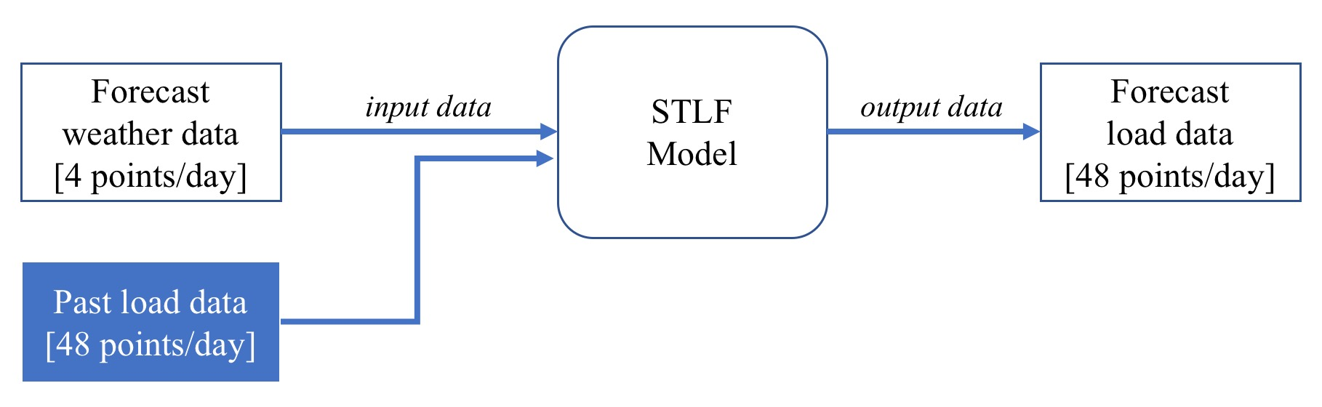
3.b. Data pre-processing strategies
In short, the forecasting method is based on historical load data and takes weather forecast as a hint to predict future load data.

Slide 14
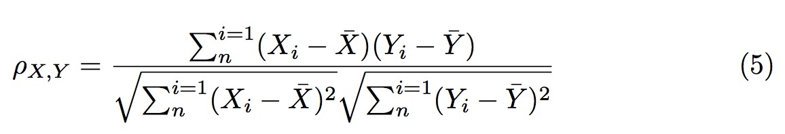
3.c. Correlation study
NEM load data will be used not only as label data but also as feature data
Selecting the right amount of data and the appropriate features of data as input data is an important process that must be performed first for accurate load forecasting [15].
We used Pearson's correlation coefficient (PCC) to track the relationship between date and load data.

Slide 15
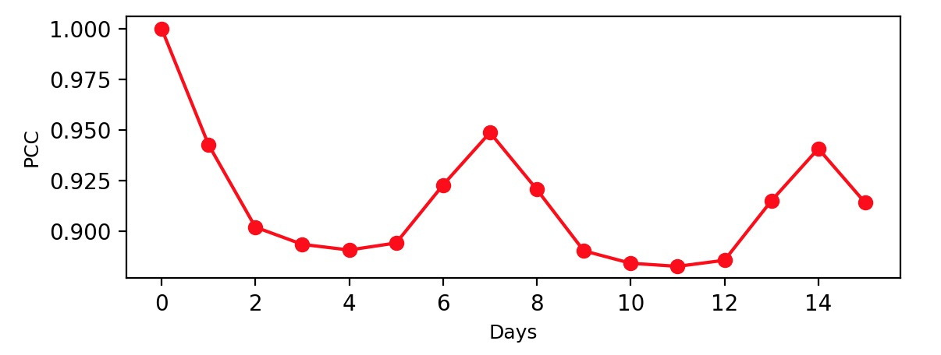
3.c. Correlation study
As a result, the load data of the previous day and the week before showed the highest PCC value.
We set the strategy to add the load data of just before and one week before to input feature dataset.

Slide 16
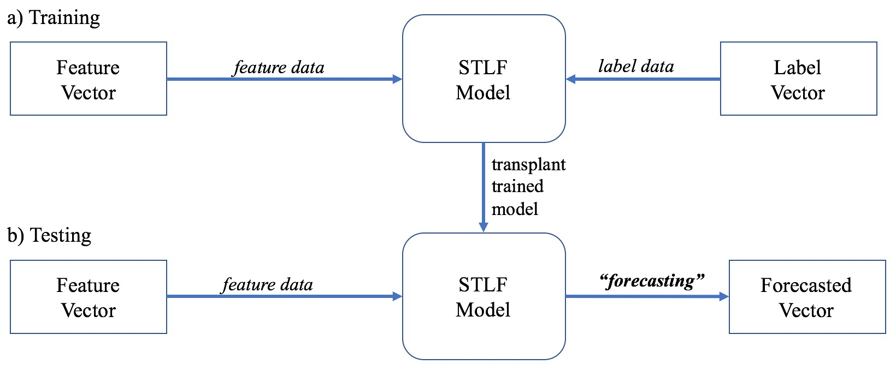
3.d. STLF architecture
We will compare the performance of each STLF architecture implemented with ELM and H-ELM.
Notes:
This architecture is divided into two phases: a) training and b) testing.
In the a) training phase, the learning model receives the feature vector obtained through the data pre- processing process and performs model training. The STLF model trained in this phase is used in the next phase.
In the b) testing phase, the feature vector is input and forecasting is performed based on the STLF model trained in the previous process.

Slide 17
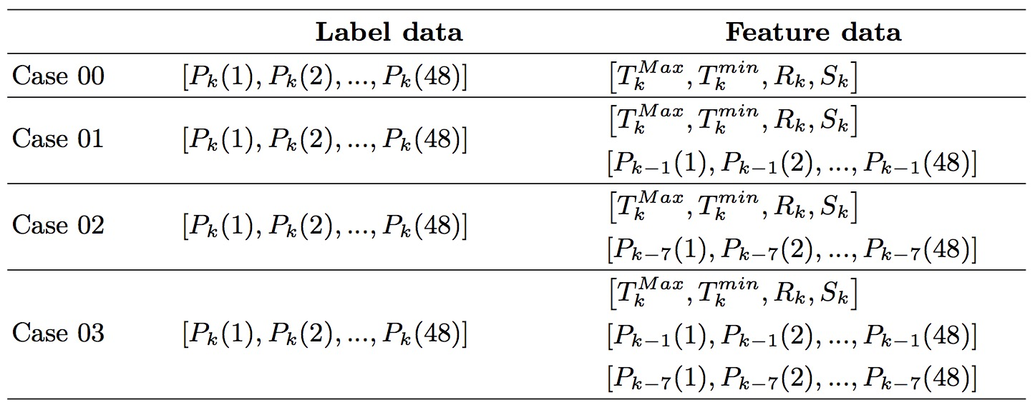
3.e. Input & Output
Input data consists of feature data and label data
Output value is forecasted daily load profile, namely the 48 load points corresponding to each half-hour of a day.
Notes:
In this experiment, we will confirm the role of data pre-processing in addition to the performance comparison between ELM and H-ELM.
Therefore,
based on the PCC results, we propose the following 4 cases.

Slide 18
4. Test Results
Optimal number of hidden nodes
Performance comparison between ELM and H-ELM

Slide 19
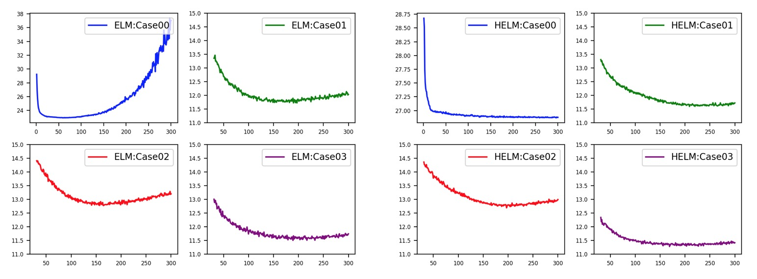
4.a. Optimal number of hidden nodes
The STLF model designed in this experiment needs to be optimized for maximum performance, which is the task of determining the number of hidden nodes.
Notes:
The STLF model designed in this experiment needs to be optimized for maxi- mum performance, which is the task of determining the number of hidden nodes.
the MAPE method was used to measure accuracy, and the forecasting accuracy result obtained from this optimization process corresponds to the average value of the same 20 repetitive prediction experiments.
In each case, the number of hidden nodes for the optimization of the STLF model slightly differed, and the results of the experiment for the optimization are shown in Figure.

Slide 20
4.b. Performance : ELM vs. H-ELM
The accuracy of the prediction is evaluated using MAPE and MAE.
The stability of the prediction is evaluated as the standard deviation of the distribution of the prediction accuracy.
In order to measure these two evaluation items, 1,000 identical repeating experiments were conducted for each STLF model.
In order to evaluate the accuracy, the mean value of MAPE and MAE values was taken as the final value, and the standard deviation was calculated to evaluate the stability.

Slide 21
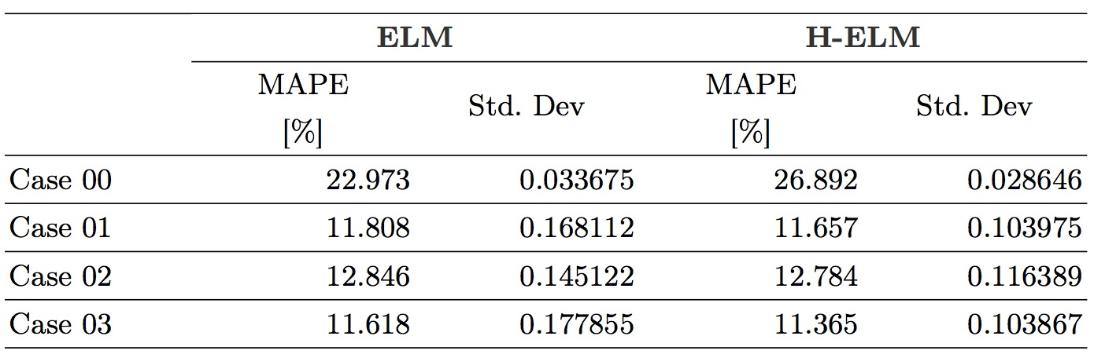
4.b. Performance : ELM vs. H-ELM
Forecasting MAPE and stability

Slide 22
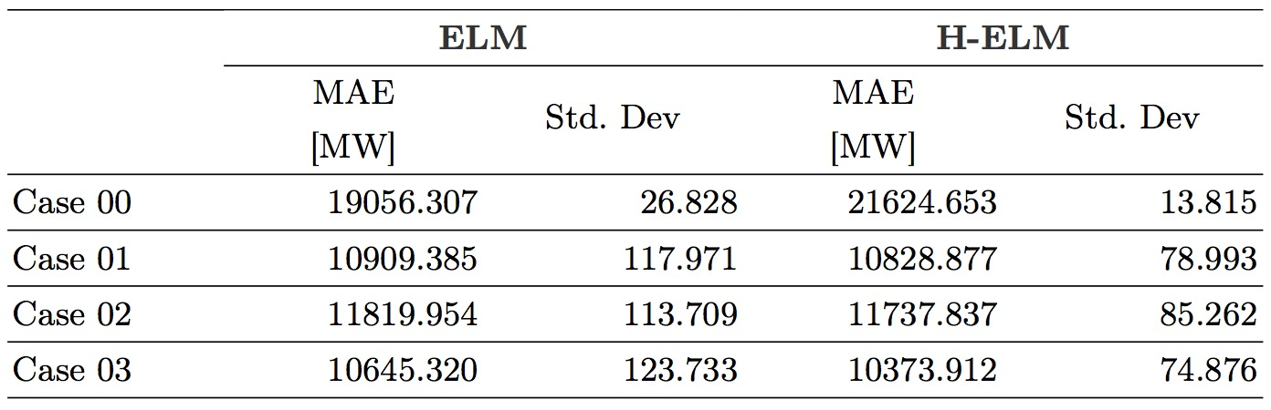
4.b. Performance : ELM vs. H-ELM
Forecasting MAE and stability

Slide 23
5. Conclusion
Improvement of Learning Algorithm
Due to the characteristics of ELM, the output value of the ELM SLTF is unstable, which degrades the accuracy of prediction.
By constructing the STLF model through H-ELM, it is possible to solve the instability of the output value and able to get more accurate prediction.
Data pre-processing
Data pre-processing plays a significant role in improving the performance of the STLF model.
In summary, in order to improve the performance of the STLF, it is necessary to construct a STLF model using H-ELM and to input well-defined input features through proper data pre-processing.

Slide 24
6. References
1. Zhiyi Li, Xuan Liu, Liyuan Chen, "Load Interval Forecasting Methods Based on An Ensemble of Extreme Learning Machines," Power & Energy Society General Meeting, 2015 IEEE, October 2015.
2. Guang-BinHuang,ErikCambria,“ExtremeLearningMachines,”IEEETransactions on Cybernetics, vol. 28, no. 6, pp. 30-59, 2013.
3. G.-B.Huang,Q.-Y.Zhu,andC.-K.Siew,“ExtremeLearningMachine:ANewLearn- ing Scheme of Feedforward Neural Networks,” 2004 International Joint Conference on Neural Networks (IJCNN’2004), July 25-29, 2004.
4. Rui Zhang, Zhao Yang Dong, Yan Xu, Ke Meng, Kit Po Wong, "Short-term load forecasting of Australian National Electricity Market by an ensemble model of ex- treme learning machine," December 2012.
5. Muhammad Qamar Raza, Dr-Badar Islam, M. A. Zakariya, "Neural Network Based STLF Model to Study the Seasonal Impact of Weather and Exogenous Variables," Research Journal of Applied Sciences, Engineering and Technology · November 2013.
6. Damitha K. Ranaweera, George G. Karady, Richard. C. Farmer, "Economic Impact Analysis of Load Forecasting," IEEE Transactions on Power Systems, Vol. 12, No. 3, August 1997.
7. C.L. Wu, K.W. Chau, C. Fan, "Prediction of rainfall time series using modular artificial neural networks coupled with data-preprocessing techniques," Journal of Hydrology Volume 389, Issues 1–2, 28 July 2010.
8. Huang, G.-B., Zhu, Q.-Y., Siew, C.-K, "Extreme learning machine: theory and ap- plications," Neurocomputing, 2006, 70, pp. 489–501
9. Bartlett, P.L., "The sample complexity of pattern classification with neural net- works: the size of the weights is more important than the size of the network," IEEE Trans. Inf. Theory, 1998, 44, (2), pp. 525–536

Slide 25
6. References
10. Jiexiong Tang, Chenwei Deng, Guang-Bin Huang, "Extreme Learning Machine for Multilayer Perceptron," IEEE transactions on neural Network and learning systems, Vol. 27, No. 4, April 2016.
11. Pradeep C.Gupta, Keigo Yamada, "Adaptive Short-Term Forecasting of Hourly Loads Using Weather Information," IEEE Transactions on Power Apparatus and Systems, Volume: PAS-91, Issue: 5, Sept. 1972, pp. 2085-2094
12. Muhammad Qamar Raza, Zuhairi Baharudin, Badar-Ul-Islam, Mohd. Azman Za- kariya, Mohd Haris Md Khir, "Neural Network Based STLF Model to Study the Seasonal Impact of Weather and Exogenous Variables," Intelligent and Advanced Systems (ICIAS), 2014 5th International Conference on, August 2014.
13. S.J.Kiartzis, C.E. Zoumas, A.G.Bakirtzis,V. Petridis, "Data Pre-Processing For Short-Term Load Forecasting In An Autonomous Power System Using Artificial Neural Networks," Electronics, Circuits, and Systems, 1996. ICECS ’96., Proceed- ings of the Third IEEE International Conference on, October 1996
14. Agnaldo J. Rocha Reis, Alexandre P. Alves da Silva, "Feature Extraction via Mul- tiresolution Analysis for Short-Term Load Forecasting," IEEE TRANSACTIONS ON POWER SYSTEMS, VOL. 20, NO. 1, February 2005.
15. Abdussalam Mohamed, M. E. El-Hawary, "Effective Input Features Selection For Electricity Price Forecasting," 2016 IEEE Canadian Conference on Electrical and Computer Engineering (CCECE)
16. Bunn, D.W., Farmer, E.D. (Eds.), "Comparative models for electrical load fore- casting" (John Wiley & Sons, 1985)
17. Australian Energy Market Operator [Online]. Available at http://www.aemo.com. au
18. Bureau of Meteorology of Australian Government [Online]. Available at http:// www.bom.gov.au/index.shtml

